Slide 1

Salient object detection
Advisor
Dr. Maryam Abedi
Student
Mohammad Shahpouri
Fall
2021

Slide 2
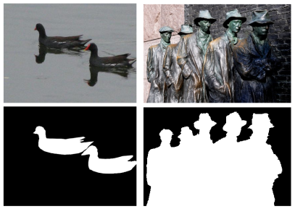
What is salient object detection?
Salient object detection or salient object segmentation
Detecting the most salient object
Segmenting the accurate boundary of that object
Gupta, A.K.; Seal, A.; Prasad, M.; Khanna, P. Salient Object Detection Techniques in Computer Vision—A Survey. Entropy 2020, 22, 1174. https://doi.org/10.3390/e22101174

Slide 3
Salient object detection models
Block-based and region-based
  Edge, blob, texture, corner
Intrinsic cues and extrinsic cues
  Ground-truth annotations of the training images
  Similar images
  The video sequence
  A set of input images containing the common salient objects
  Depth maps
  Light field images

Slide 4
Applications of Salient Object Detection
Object detection and recognition
Image and video compression
Video summarization
Photo collage/media re-targeting/cropping/thumb-nailing
Image quality assessment
Image segmentation
Content-based image retrieval and image collection browsing
Image editing and manipulating
Visual tracking
Object discovery
Human-robot interaction

Slide 5
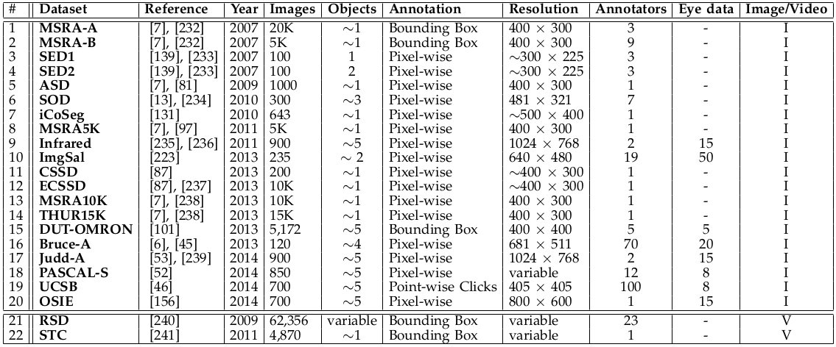
Datasets for salient object detection

Slide 6
Evaluation Measures
Precision-recall (PR)
F-measure
Receiver operating characteristics (ROC) curve
Area under ROC curve (AUC)
Mean absolute error (MAE)

Slide 7
Reference
Borji, A., Cheng, MM., Hou, Q. et al. Salient object detection: A survey. Comp. Visual Media 5, 117–150 (2019). https://doi.org/10.1007/s41095-019-0149-9

Slide 8
Thank you

